Slide 1
Processor Arch: Pipelined
Program optimization
MADE BY: Zhong Zhineng & You Zhenbang

Slide 2
Processor Arch: Pipelined

Slide 3
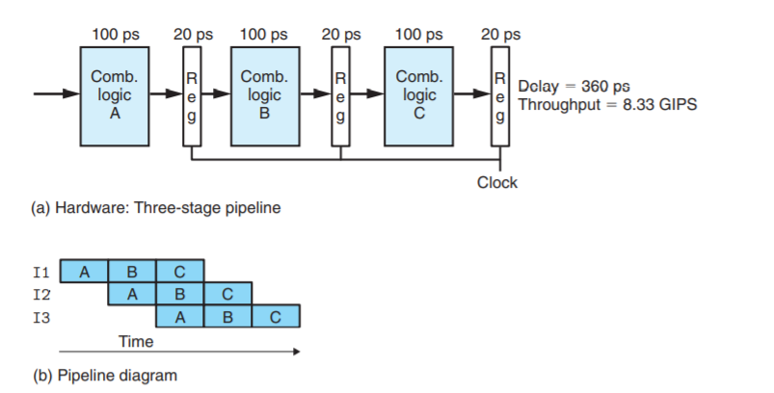
Pipeline Basics
What’s the change of throughput and latency respectively?

Slide 4
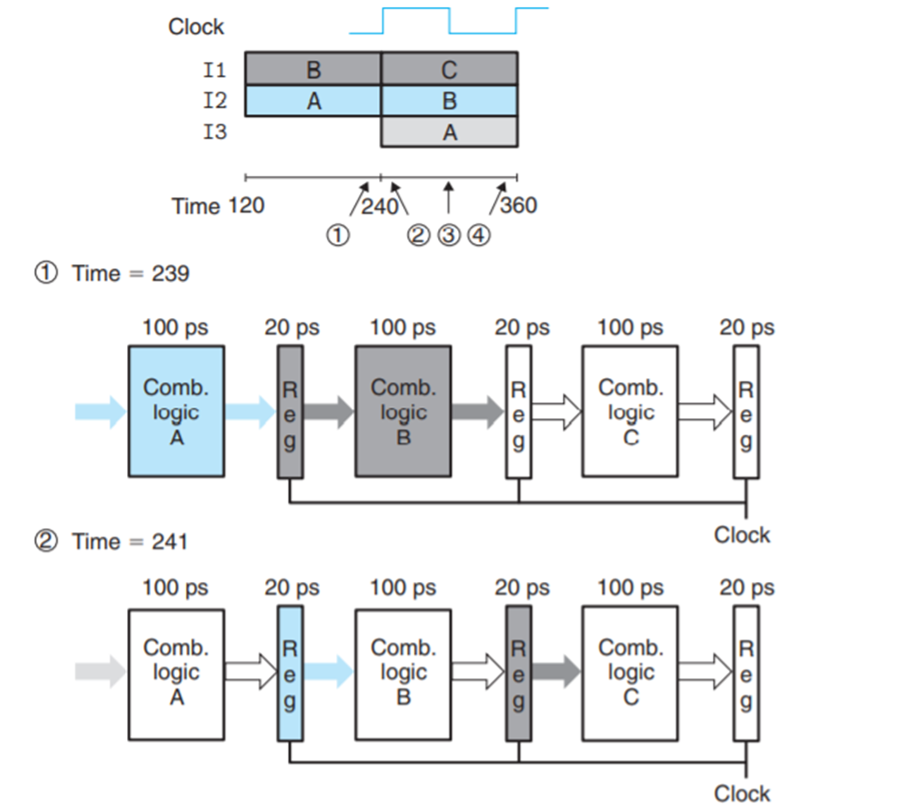
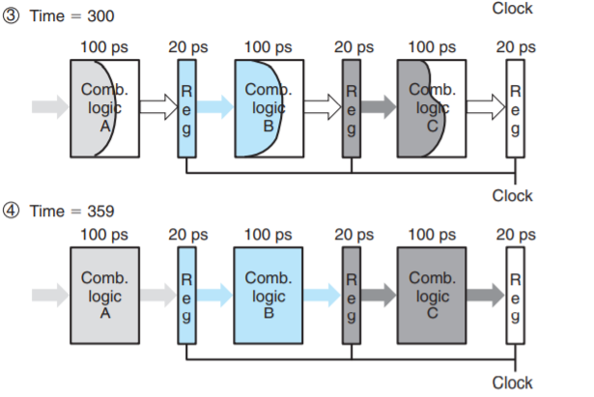
Pipeline Basics

Slide 5
Pipeline Basics
Limitations of pipelining
Nonuniform partitioning
Diminishing Returns of Deep Pipelining
Number of pipeline stages of modern CPU
AMD Zen2(3th Gen Ryzen): 19 stages
Intel Ice Lake(10th Gen core): 14-19 stages

Slide 6
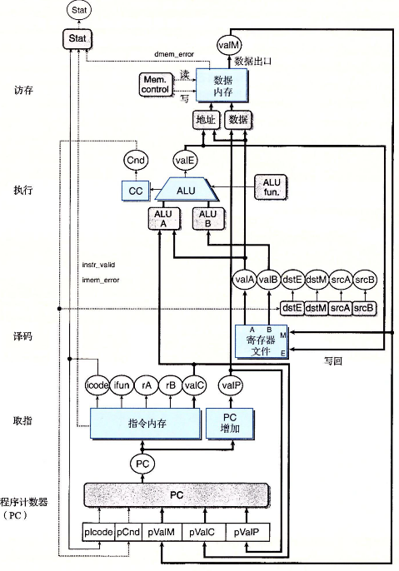
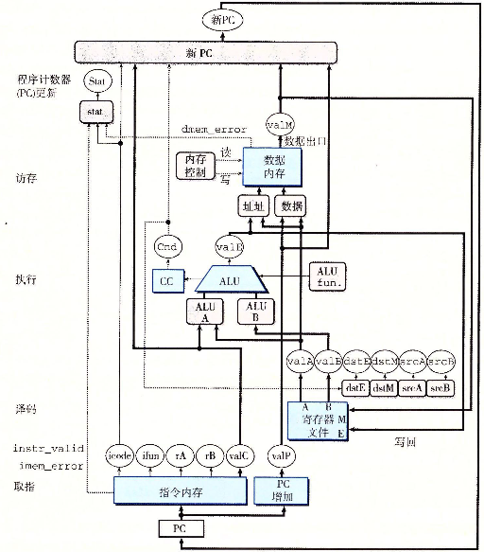
SEQ->SEQ+

Slide 7
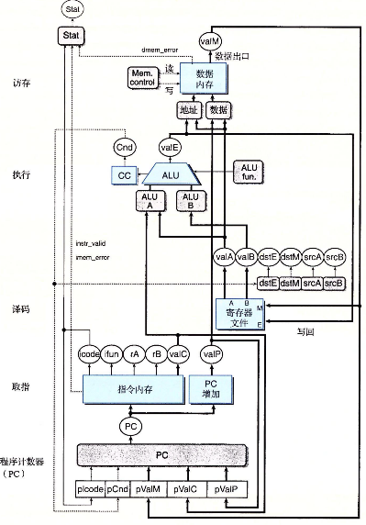
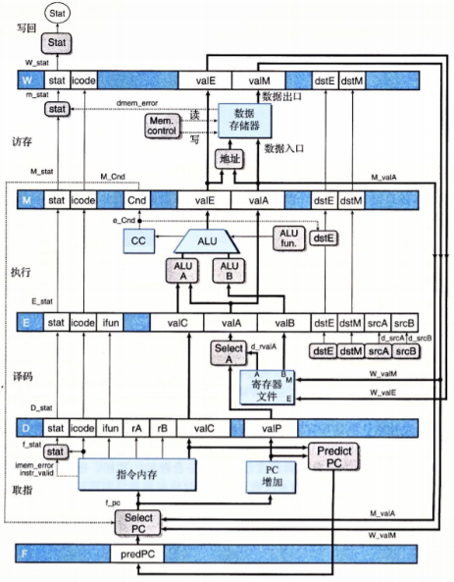
SEQ+->PIPE-
Adding pipeline registers
Since valP is only used in the Memory period of call and in the Execute period of jXX and both of them do not need valA, Select A module is used to reduce the number of registers.

Slide 8
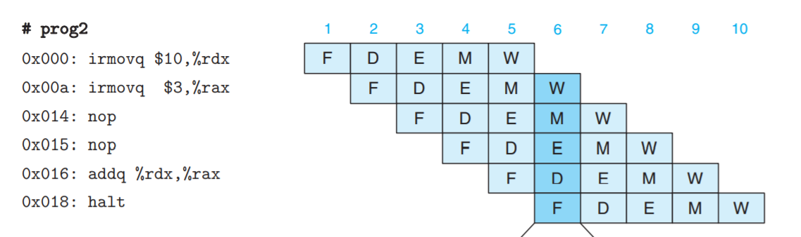
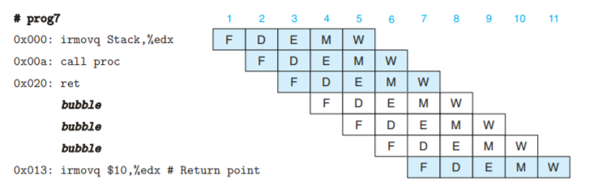
Problems: Data/Control Dependency
Data hazard
Control hazard
(if there were no bubbles)

Slide 9
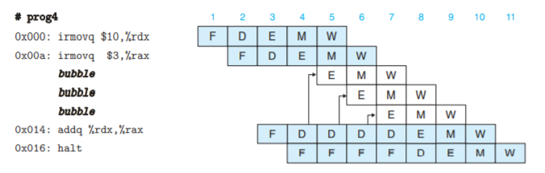
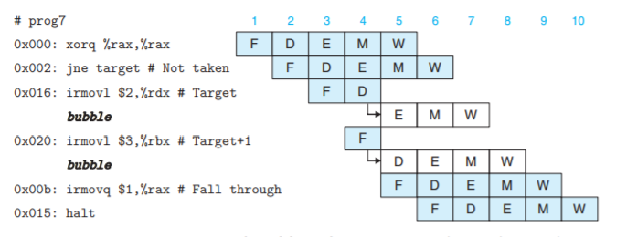
A Simple Solution: Bubbles and Stalls
Handling data hazard
Handling control hazard

Slide 10

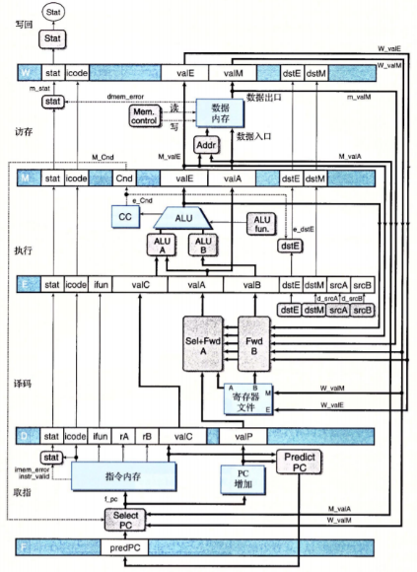
Another Solution: Forward
Problem: Need the data that has not written back to the registers when decoding
Another solution: Forward the data
Our principle: Try to use forward. If that fails, we can use stalls.

Slide 11
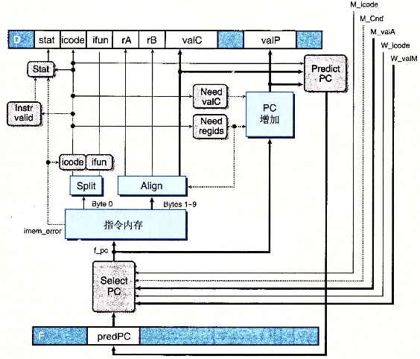
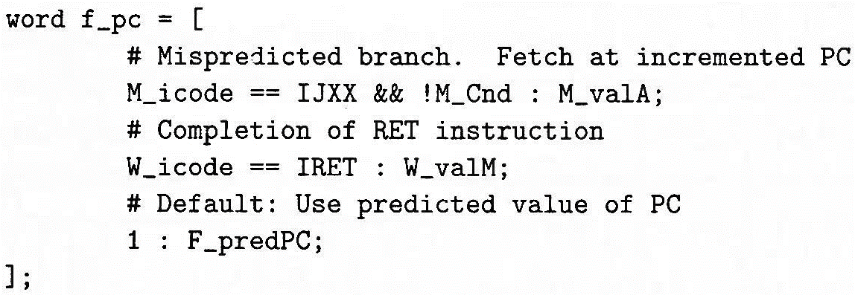
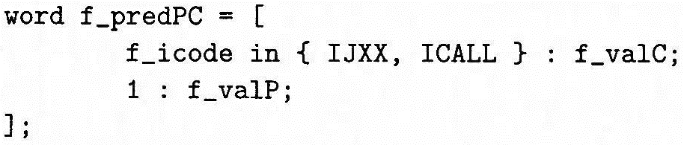
Modified HCL: Select PC & Fetch
HCL:

Slide 12
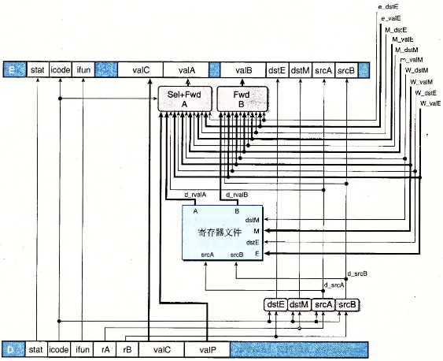
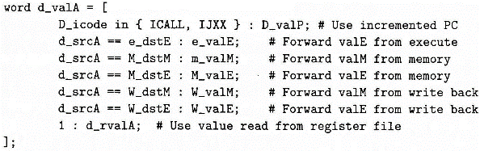
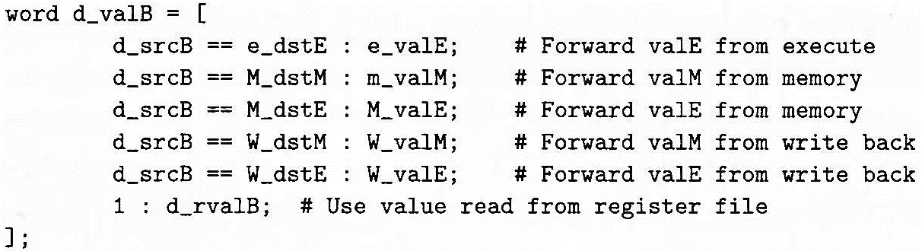
Modified HCL: Decode/Write back
HCL:
Pay attention to the order.

Slide 13
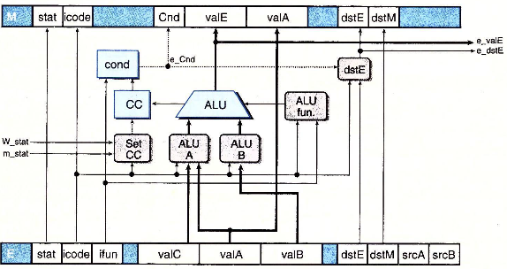
Modified HCL: Execute
HCL:

Slide 14
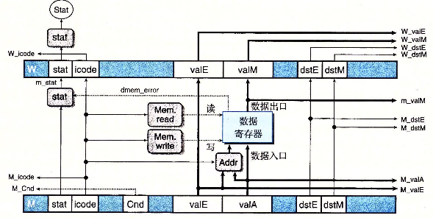
Modified HCL: Memory
HCL:

Slide 15
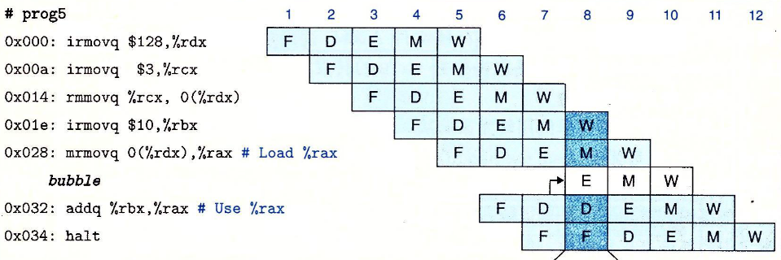
Hazard: Load/Use
—— You cannot only use forwarding to solve all the problems.
上一条指令从内存读入寄存器（Memory阶段读出），本条指令需要用寄存器中的值
只转发做不到，只能暂停流水线，插入一个气泡，同时从Memory阶段转发到Decode

Slide 16
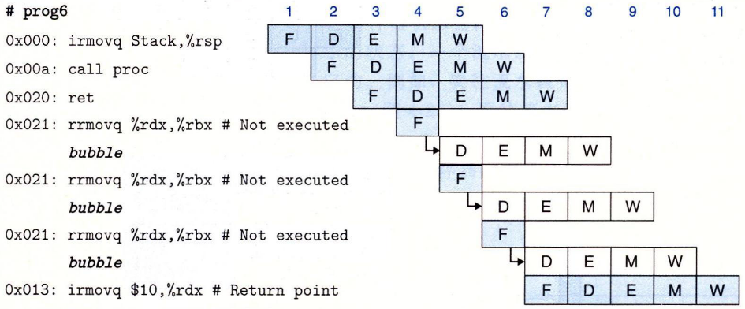
Hazard: ret
ret指令后一条指令的PC需要到Memory阶段才知道
解决方案：暂停流水线，插入三个气泡

Slide 17
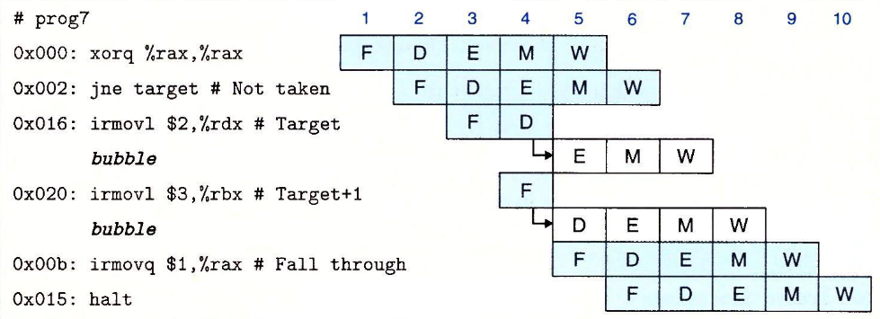
Hazard: Branch Misprediction
执行完Execute阶段就可以知道正确分支（Cnd）
解决方案：暂停流水线，插入两个气泡

Slide 18
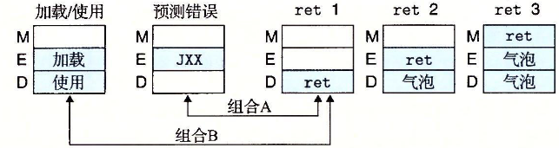
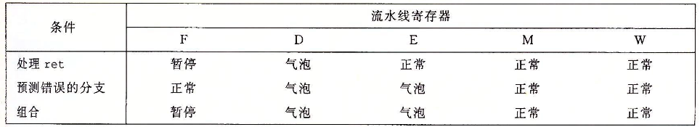
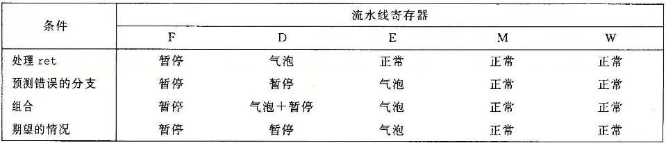
Hazard Combination

Slide 19
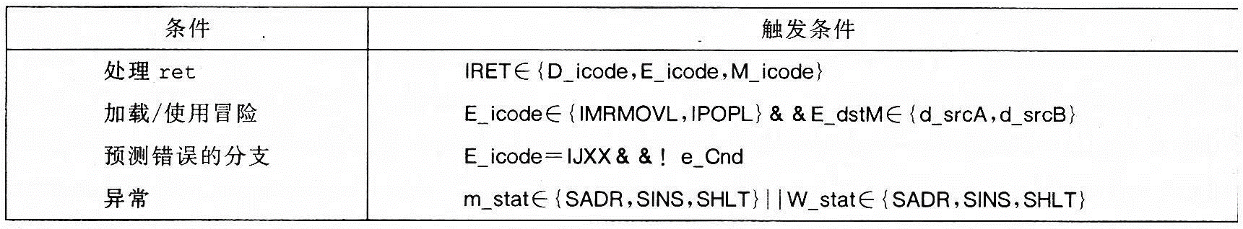
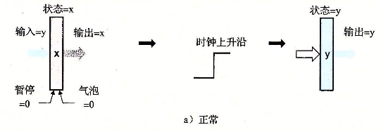
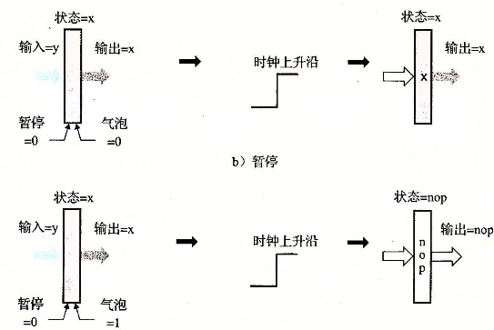
Hazard Detection & Control

Slide 20
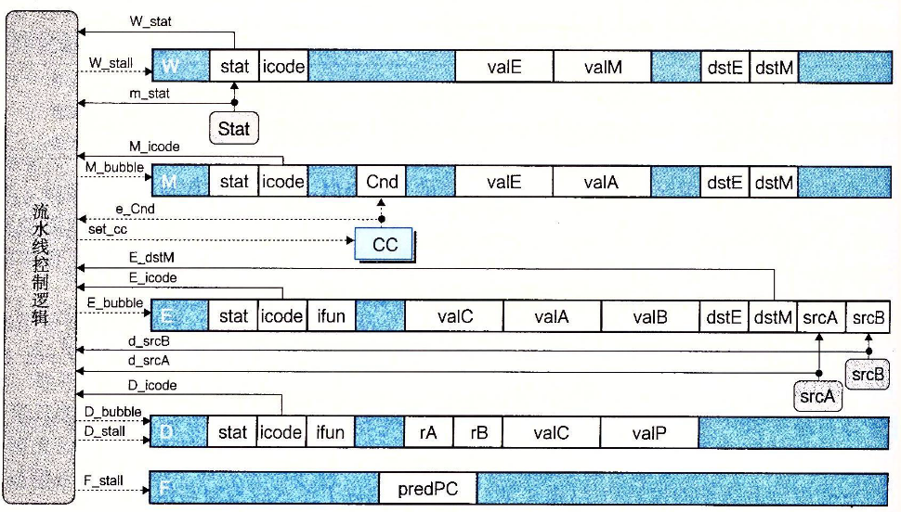
Implementing Pipeline Control

Slide 21
Program optimization

Slide 22
Optimization
编译器可以进行的优化：
代码移动，比如将循环中相同重复计算提取到循环外
移位加减等代替乘除
部分表达式的复用
编译器必须保守而不能进行的优化：
过程调用可能有副作用
指针可能具有别名

Slide 23
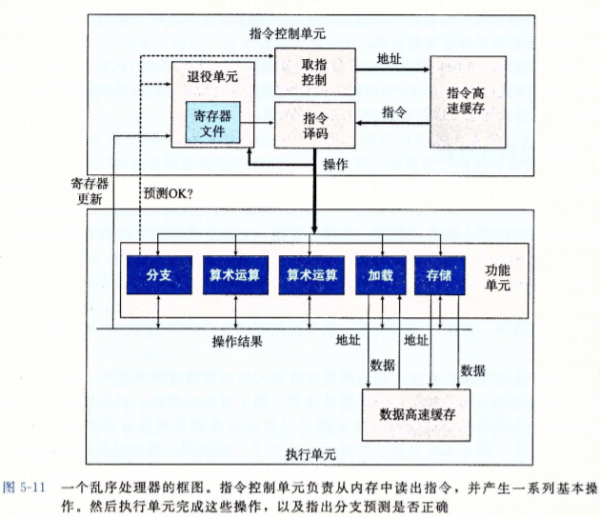
Simple Out-of-order Processor
In-order issue
Out-of-order execution
In-order commit
CPI may be less than 1

Slide 24
Modern CPUs
Out-of-order execution
Multiple issue
Dynamic scheduling
Speculative execution
Advanced prediction mechanisms
Register renaming

Slide 25
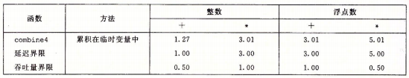
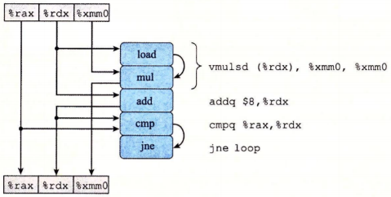
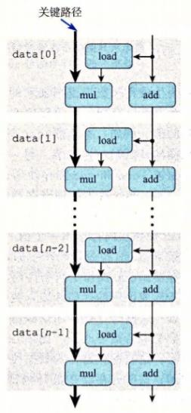
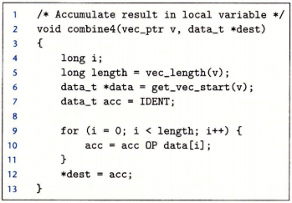
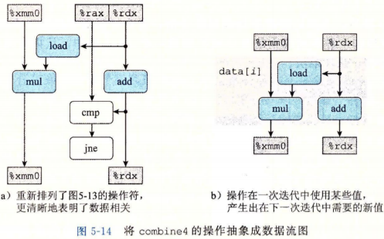
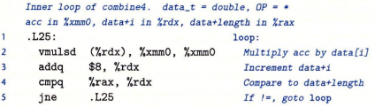
数据流图和关键路径
关键路径提供的只是一个下界
还受到功能单元的数量, 功能单元之间能够传递数据值的数量影响

Slide 26
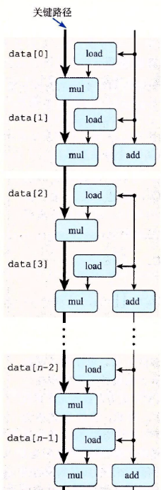
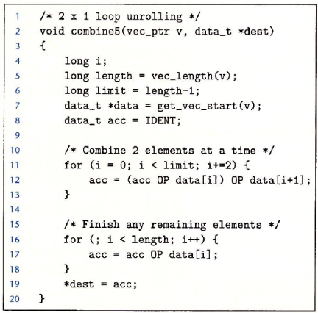
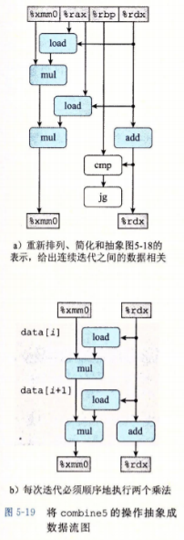
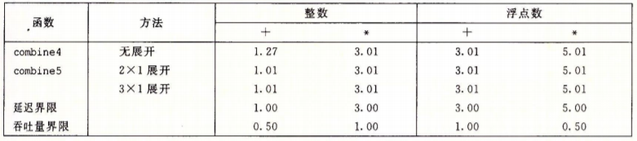
Loop Unrolling

Slide 27
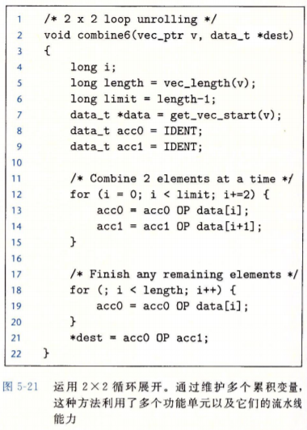
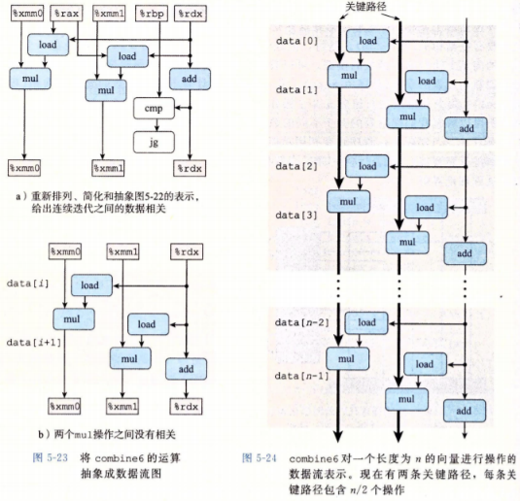
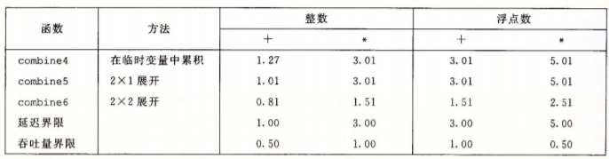
Loop Unrolling with Separate Accumulators

Slide 28
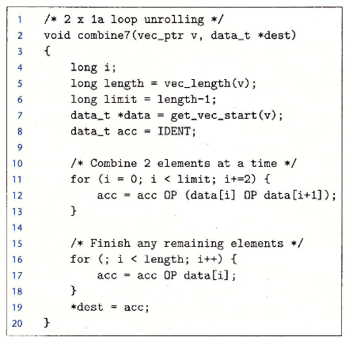
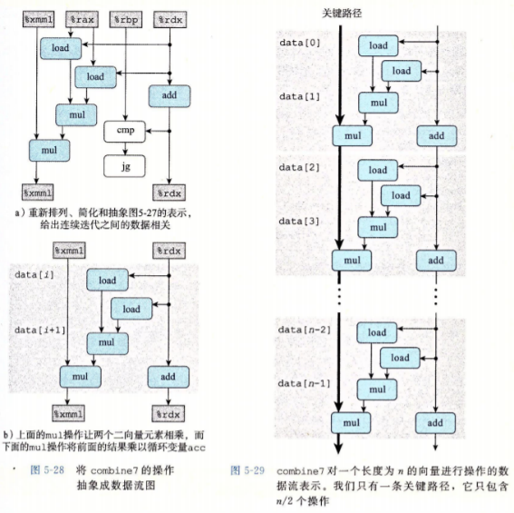
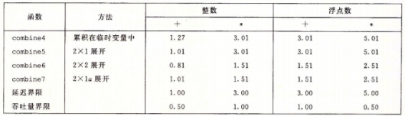
Loop Unrolling with Reassociation

Slide 29
Notes
太多次展开会导致寄存器溢出
改变运算顺序的循环展开重新结合不可以用于浮点数(浮点数不满足结合律)

Slide 30
Thanks for
your listening.

